Slide 1
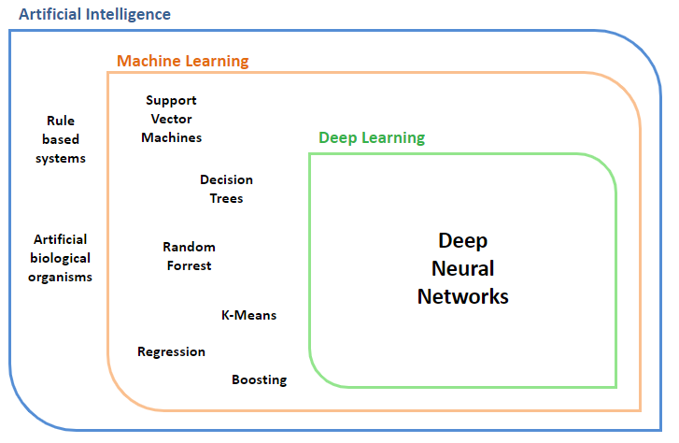
Getting Started with Deep Learning
Developed by Titus Tang, Monash Data Science and AI Platform, 2021

Slide 2
What is this lecture about?
Assumes close to zero technical knowledge about deep learning.
An introduction to deep learning at a high level.
Steps to get started with deep learning hands-on.
Pointers to more resources.
What is this lecture NOT about?
In-depth discussion about how things work "inside the box".
Technical discussion about implementation.
Machine Learning.
Notes:
This lecture is presented almost as a checklist of things you need to know or prepare for in order to get started with deep learning.

Slide 3
How is Deep Learning Useful?

Slide 4
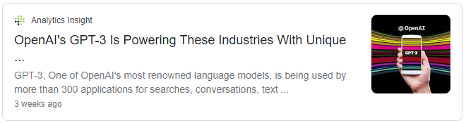
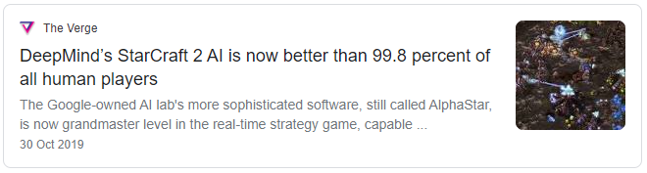
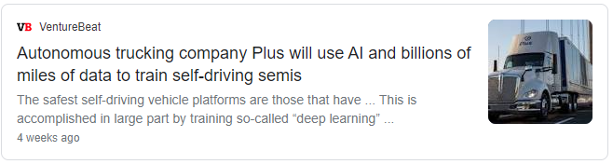
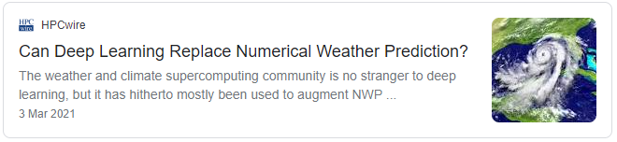
Notes:
Example applications showing the practical utility of DL. Feel free to pick and choose, or add your own depending on target audience.

Slide 5
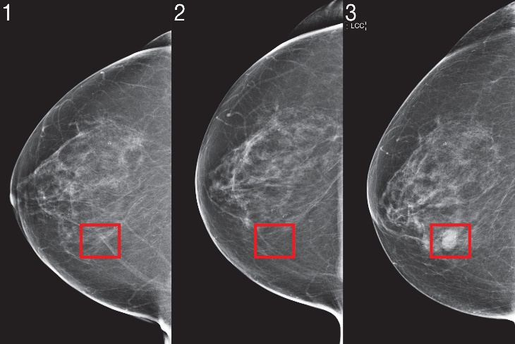
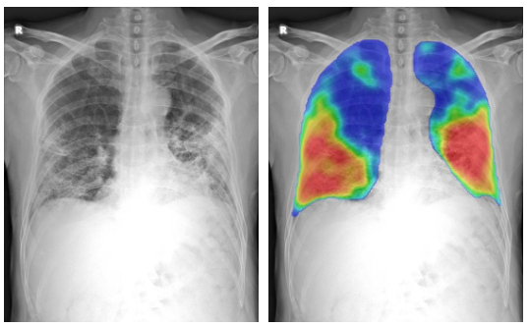
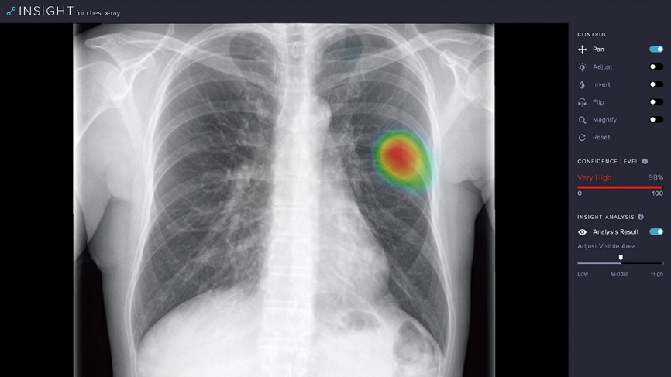
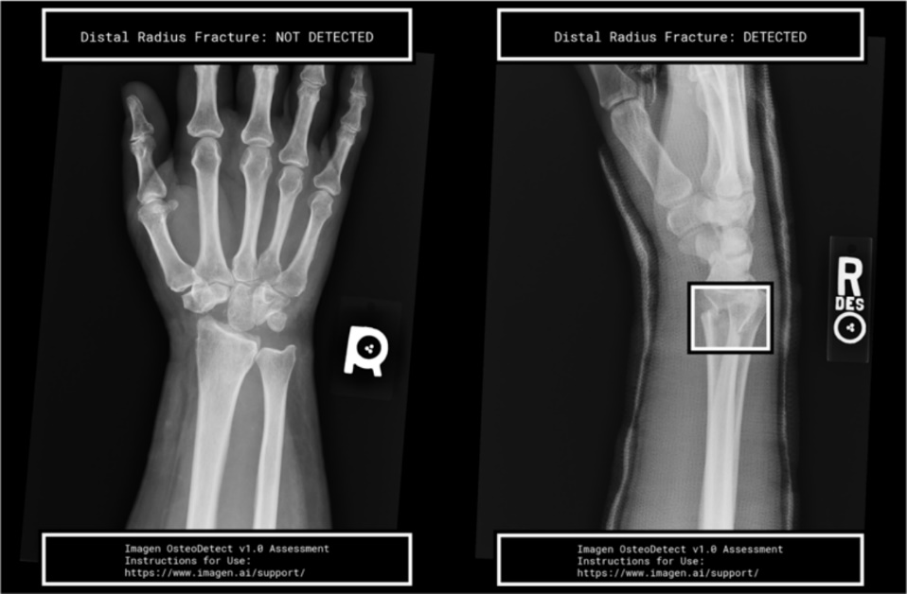
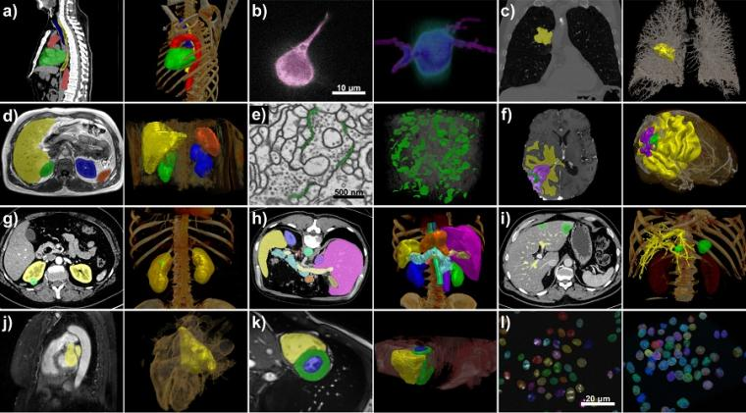
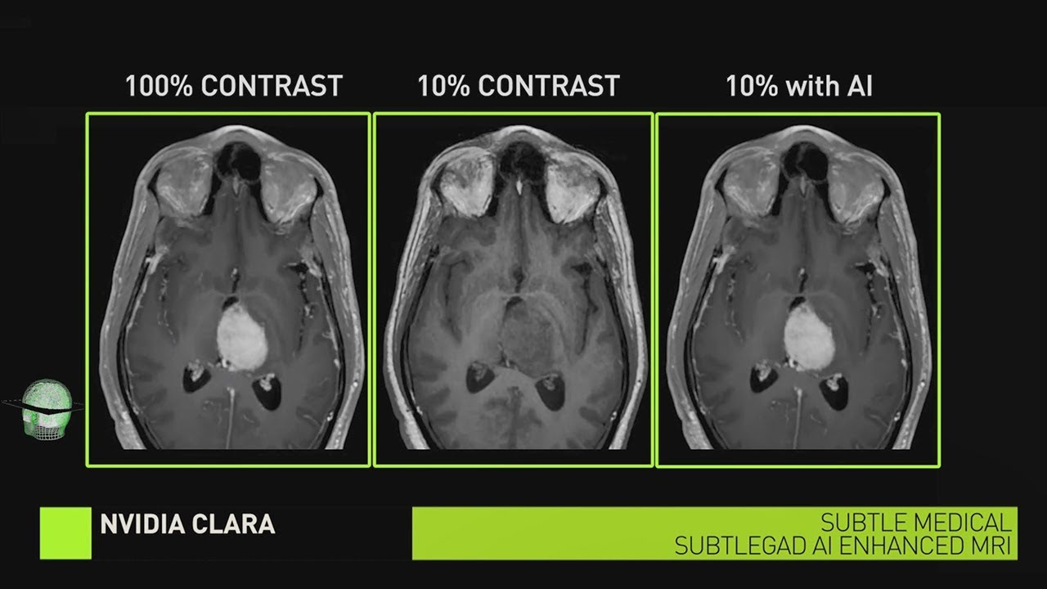
Notes:
Example applications showing the practical utility of DL. Feel free to pick and choose, or add your own depending on target audience.

Slide 6
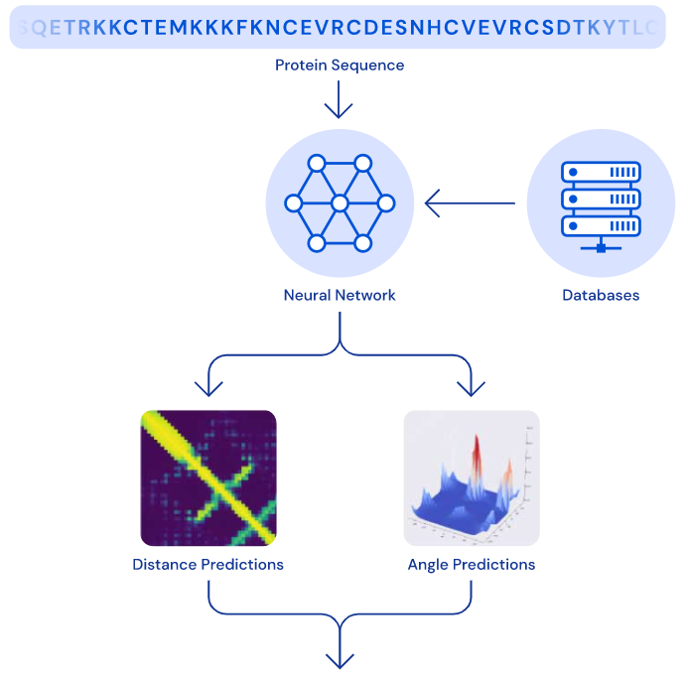
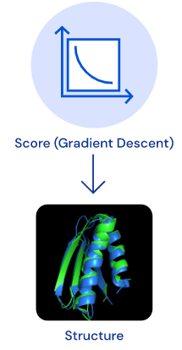
Alpha Fold
An AI that predicts the 3D structure of a protein based solely on its genetic sequence.
Why? Structure of a protein influences how it behaves in an organism. Malfunction often leads to disease.
Modelling the physical structure of a protein is difficult. Genetic sequencing is easier.
How? A deep neural network that predicts the distance between pairs of amino acids, and angles between chemical bonds that connect those amino acids.
Won first place at CASP13 global competition.
Source: https://deepmind.com/blog/article/AlphaFold-Using-AI-for-scientific-discovery
Notes:
Example applications showing the practical utility of DL. Feel free to pick and choose, or add your own depending on target audience.

Slide 7
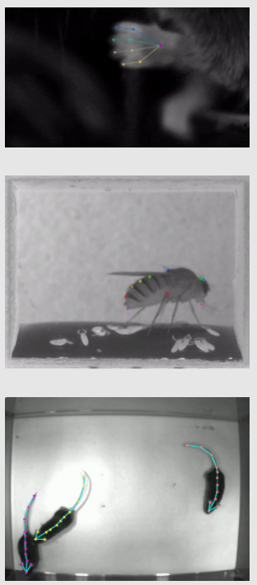
DeepLabCut
3D markerless pose estimation using neural networks.
Able to track various body parts in multiple species across a broad collection of behaviours.
Available as a Python package that is open source, fast, robust and requires minimal training data to fine tune to your use case.
Source: http://www.mackenziemathislab.org/deeplabcut
Notes:
Example applications showing the practical utility of DL. Feel free to pick and choose, or add your own depending on target audience.

Slide 8
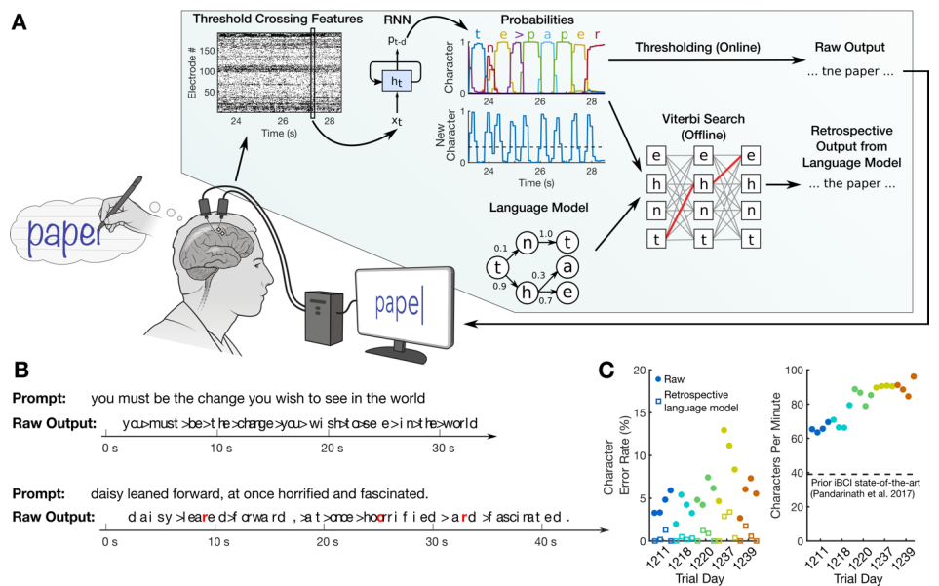
Brain to text communication
User imagines writing – neural network predicts user intentions.
How? Neural activity in the motor cortex is recorded and fed into a Recurrent Neural Network. Network predictions are denoised with a language model.
User was able to “write” 90 characters per minute at >99% accuracy with a general-purpose autocorrect (Age adjusted able-bodied smartphone typing speeds ~115 cpm).
Source: https://www.biorxiv.org/content/10.1101/2020.07.01.183384v1.full.pdf
Notes:
Example applications showing the practical utility of DL. Feel free to pick and choose, or add your own depending on target audience.

Slide 9
What is Deep Learning?

Slide 10


Programming vs Deep Learning
vs
How would you traditionally design code that categorises images of dogs and cats?

Slide 11
vs
Traditional software development
New data
Observe data
Identify features
Hand-code features
Deploy Algorithm

Slide 12
vs
Traditional software development
New data
Observe data
Identify features
Hand-code features
Deploy Algorithm
Deep Learning
New data
Collect data
Label data
Neural Network
Deploy Model

Slide 13
vs
Traditional software development
New data
Observe data
Identify features
Hand-code features
Deploy Algorithm
Traditional software development automates the process of executing instructions
Deep Learning
New data
Deep learning automates the process of defining those instructions!
Collect data
Label data
Neural Network
Deploy Model

Slide 14
AI vs ML vs DL
Artificial Intelligence
Machine Learning
A machine that autonomously learns biases from data.
Support Vector Machines
Rule based systems
Deep Learning
Any human designed system that provides consistent and beneficially biased output in response to input.
Decision Trees
Artificial biological organisms
Random Forrest
Deep Neural Networks
K-Means
Regression
Boosting

Slide 15
What is a Deep Neural Network?

Slide 16
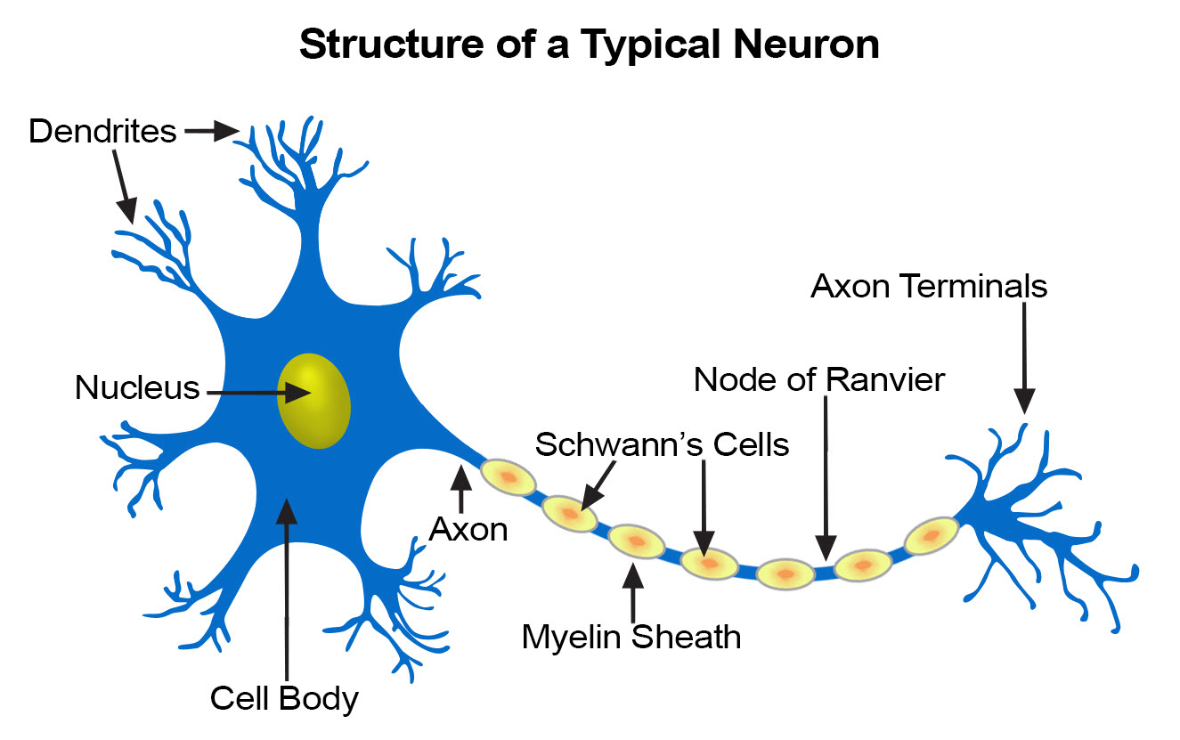
One Neuron
Modelled after neurons in the brain.
Each neuron takes input from multiple sources.
Neuron aggregates information and passes output to next layer.
Fundamental unit – an artificial neuron, a perceptron.
Source: https://training.seer.cancer.gov/anatomy/nervous/tissue.html

Slide 17
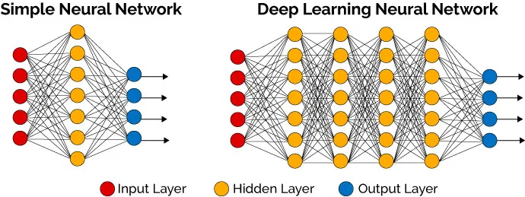
Many, many neurons
Source: https://thedatascientist.com/what-deep-learning-is-and-isnt/

Slide 18
How does a Neural Network learn?
Through a "Trial-and-Error" process – via gradient descent.
The network's output is compared to a label (the truth).
The loss (error) is calculated and used to guide the learning process.
Keywords: Gradient Descent, Back-Propagation.
Input
NN
Output
Label
-
Loss

Slide 19
How do I get started with Deep Learning?

Slide 20
Getting started – a checklist
The Basics
The Next Steps
Understand basic Data Science concepts.
Understand basic Deep Learning concepts.
Understand the Deep Learning workflow.
Know how to code (in Python).
Choose a DL library - TensorFlow or PyTorch.
Get your hands dirty – run some code, train a model.
Prepare the right dataset.
Pick the right tool - learn about neural network variants.
Get the right computing hardware.
Think about deployment.

Slide 21
Essential concepts you need to know
General Data Science
Deep Learning
Data cleaning and wrangling.
Training vs. Validation vs. Test datasets.
Overfitting vs. Underfitting a model.
Common evaluation metrics.
Supervised vs. Unsupervised learning.
Regression vs. Classification vs. Clustering.
General structure of a neural network – cells and layers.
How NNs learn – loss function, back-propagation, SGD.
Key hyperparameters – batch size, number of epochs, learning rate……
Handling inputs to the NN – input shape, order of dimensions (e.g. B, H, W, C).
Handling outputs of the NN – output shape, order of dimensions, Logits, Softmax.

Slide 22
Some deep learning resources
Beginner
Intermediate
Check with your local university for workshops, events and seminars.
Youtube: 3Blue1Brown, Two Minute Papers, Brandon Rohrer.
Blogs and articles: https://towardsdatascience.com/
Online courses: MOOC.org, Coursera…
https://playground.tensorflow.org/
Youtube: Aurélien Géron, Arxiv Insights, Henry AI Labs, Yannic Kilcher.
Blogs and articles: https://towardsdatascience.com/
Papers: https://arxiv.org/list/cs.AI/recent

Slide 23
The deep learning workflow
Collect
Data
Label
Data
Load
Data
Repeat
Train
Model
Validate
Model
Analyse Results
Select
Model
Deep Learning is
part-Art part-Science
Priorities:
Data volume and quality
Loss function
Model architecture and size
Fine tuning
Tweak
Model
Deploy Model
This is an over-simplification of the deep learning workflow as a linear model.
The real world is messy and non-linear.

Slide 24
Coding in Python
Python is by a significant margin the most popular in language in the DL community.
Understand that there are multiple versions of Python – may or may not affect you.
Know about Python packages – if you need it, it probably exists somewhere.
Commonly used packages for DL – numpy, pandas, matplotlib, opencv, (scipy, scikit-learn).

Slide 25

Notes:
TF1 was hard to use but best option at that time.
Pytorch was introduced and much easier to use than TF1, so people migrated over.
TF2 came by, big changes, pretty much similar in feel and usage to Pytorch.
At the end of the day, it is largely personal preference / choose to suit your team.

Slide 26
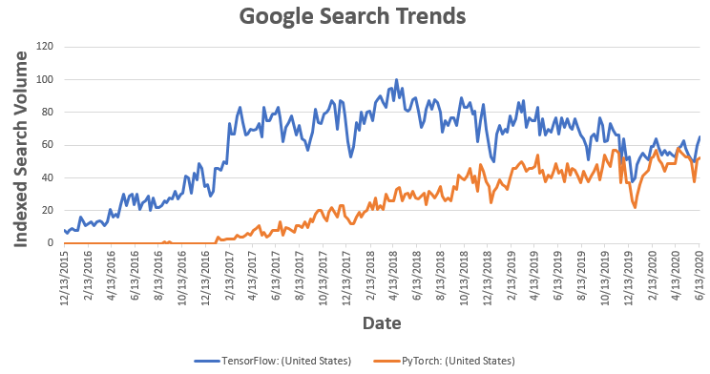
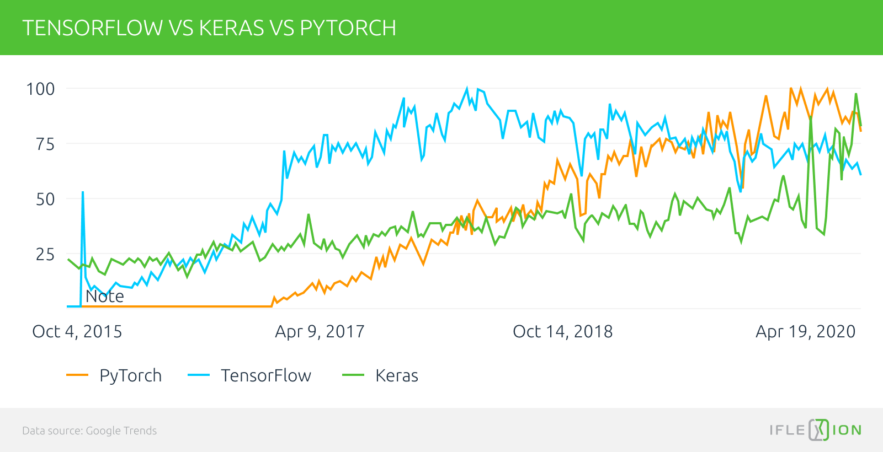
Notes:
TF1 was hard to use but best option at that time.
Pytorch was introduced and much easier to use than TF1, so people migrated over.
TF2 came by, big changes, pretty much similar in feel and usage to Pytorch.
At the end of the day, it is largely personal preference / choose to suit your team.

Slide 27
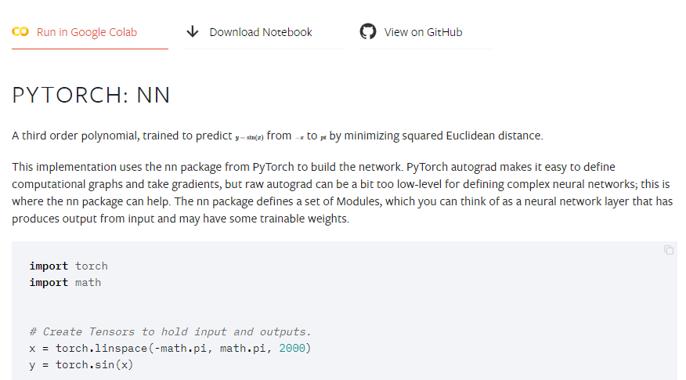
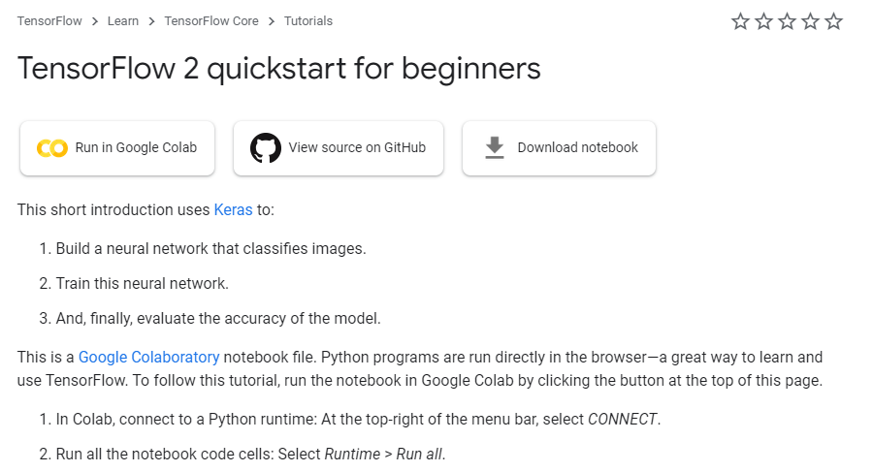
Getting started with TensorFlow and PyTorch
The official websites are a great resource.
https://www.tensorflow.org/tutorials
https://pytorch.org/tutorials/
You can easily run the tutorial code without installation:

Slide 28
Now the fun begins….
Training your own, real model.

Slide 29
Your dataset
Good quality data is essential – garbage in, garbage out.
Think about:
What types of data you will need.
How much data you will need.
The quality of the data – balanced, low noise, representative.
How you will collect data.
How you will store data in a manner that makes retrieval efficient.
How you will label your data.
Notes:
Datasets vary widely by problem and project – it is difficult to provide detailed advice here.

Slide 30
Pick the right neural network architecture
Input
shape
Backbone
Output
shape
Loss
Function
Head
Data flow
Choose the right neural network architecture for the problem at hand.
The "backbone" (body) depends on data type:
Spatially related data (e.g. images) - Convolutional Neural Networks (Conv-nets).
Time series data (e.g. natural language, waveforms, signals) - Recurrent Neural Networks, LSTMs, Transformer models.
Tabular, categorical, numerical data – usually multiple dense (fully connected) layers will do.

Slide 31
Pick the right neural network architecture
The "head" (output) and loss function depends on model objective:
Classification – probably Cross Entropy Loss.
Image segmentation – a U-net backbone with Cross Entropy Loss.
Object detection – bounding box predictions.
Other popular branches of Deep Learning:
Generative Adversarial Networks (GANs) - learning and representing distributions - "creative AI".
Reinforcement Learning – self-learning in a simulated (for now) environment.
Unsupervised, semi-supervised, or self-supervised learning– training models with limited labels.

Slide 32
Pick the right computing hardware
A laptop or desktop PC (CPU only) is sufficient for experimenting with toy models.
For serious compute, you need to look at GPUs (or TPUs).
Option 1: Get a GPU for your desktop PC. Convenient but limited performance.
Option 2: Use free cloud compute (e.g. Google Colab). Free! But limited runtime and performance.
Option 3: Buy your own mini-supercomputer, e.g. NVIDIA DGX A100 – 5 Teraflops at USD200K.
Option 4: Rent compute time on cloud services such as Google Cloud Platform, AWS, Azure. Costs can add up.
Option 5: Check with your local institution for free or membership based access to HPC.

Slide 33
Think about deployment
How do you intend to use your model?
If power or compute limited, consider network pruning, reduced precision, skinnier architecture. Usually a trade-off with accuracy.
If data source is remote, consider model “on the edge” vs “in the cloud”.
If hosting for round-the-clock or public access, consider long term compute costs, up-time reliability.
If user interacts with model output, consider the right UI that creates trust in the model.

Slide 34
Reaching out for help
The deep learning community is wide and diverse – don’t struggle on your own!
Details to provide if you are seeking high level conceptual guidance:
Model output and goals.
Sample data – a picture speaks a thousand words.
Constraints and limitations – limited data, inconsistent labels, low runtime latency.

Slide 35
Reaching out for help
Details to provide if you are seeking low level technical assistance (e.g. debugging):
Model architecture, exact inputs and outputs.
Loss function.
Description of dataset – amount of data, label consistency, data augmentation.
Training regime – train/validation split, number of epochs, validation method and metrics.
Sample output and plots of performance metrics.

